Slide 1


TABLEAU SERVER
Understanding of Tableau Server
July 10, 2018

Slide 2

Agenda
01
What is Tableau Server?
02
Tableau Server Architecture
03
Scalability
04
Availability
05
Installation and Making Tableau Cluster
©
2018 CRG Solutions Pvt. Ltd

Slide 3
What is Tableau Server?
Tableau is one of the fastest evolving Business Intelligence (BI) and data visualization tool. It is very quick to deploy, easy to learn and very spontaneous to use for a customer. It has evolved into one of the fastest and easiest way to share analytics in the cloud.
©
2018 CRG Solutions Pvt. Ltd

Slide 4

Tableau Desktop
self-service visual data analysis
data
analysis
connect live
extract
static file
information
consumers
governance
collaboration
distribution
browser
mobile
email
embedded
static file
SQL
connect live
extract
security
web & mobile
users
management, automation & audit
Tableau Server
©
2018 CRG Solutions Pvt. Ltd

Slide 5
FEATURES OF TABLEAU
1. Rapidly analyze data
2. Browse and Explore
3. User-friendly Dashboards
4. Observe and Calculate
5. Share and Interact
©
2018 CRG Solutions Pvt. Ltd

Slide 6
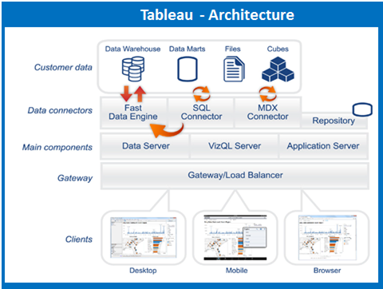
Tableau Server Architecture.
©
2018 CRG Solutions Pvt. Ltd

Slide 7

©
2018 CRG Solutions Pvt. Ltd
Key Server Components

Slide 8

Different Key Server Components
Gateway
Viz Portal
VizQL Server (Application Server)
Data Server
Cache Server
Repository
Data Engine(HYPER)
File Store
Coordination Service
Cluster Controller
©
2018 CRG Solutions Pvt. Ltd

Slide 9
Gateway
Receives incoming client requests and directs them to the appropriate service for action
Acts as a load balancer, routing traffic round-robin to service instances
Returns HTML responses to client
Single-process; multi-threaded
©
2018 CRG Solutions Pvt. Ltd

Slide 10
Viz Portal
New Viz Web Portal Navigation Pages and Content Pages
Works directly with Repository
Brand new amazing web application
Support browsing and searching
Handles REST API calls
©
2018 CRG Solutions Pvt. Ltd

Slide 11
VizQL Server (Application Server)
Provides same functionality as Tableau Desktop, processing requests related to data visualisation
Includes built-in
Load workbooks & Render Views
Responds to user interactions
Multi-server; multi-process; multi-threaded
©
2018 CRG Solutions Pvt. Ltd

Slide 12
Data Server
Serves as proxy between requests for data and individual data sources
Provide centralized metadata management for data sources and an additional layer of access control
Allows centralized driver deployment
Simplify users access to data stored
Author a calculation once and share it with everyone
Create standardized definition for each field
Manage and update many large extracts
Refresh extracts once and automatically update multiple workbooks using the same data extract
©
2018 CRG Solutions Pvt. Ltd

Slide 13
Cache Server
Acts as a shared Cache across Tableau Processes
Used by VizQL, Backgrounder and Data Server
Install on every machine running one of these processes
Think of the Cache Server as a full server cache
Add additional Cache Servers for Cache Capacity and Throughput
Persistent after restart
©
2018 CRG Solutions Pvt. Ltd

Slide 14
Repository
Stores Tableau Server metadata: users, group assignments, permissions, projects, flat files used as data sources, etc.
Responds to queries from other services when they need metadata
Also holds audit data for performance reporting
Has a SQL interface so external applications can connect (read-only)
©
2018 CRG Solutions Pvt. Ltd

Slide 15
Data Engine(HYPER)
Creates extracts and processes queries
Does the Parallel query processing
It is the component that loads extracts into memory and performs queries against them, and writes the extracts to the database
The data engine is multi-threaded to handle multiple requests at a time.
Default Query Parallelism is N Cores / 2
Max is N Cores
Could have Data Engine only Boxes
©
2018 CRG Solutions Pvt. Ltd

Slide 16
File Store
Fast replication
Recover from server-down (no data loss)
Replicate to arbitrary number of nodes, improving degree of availability
©
2018 CRG Solutions Pvt. Ltd

Slide 17
Coordination Service
Stores information from Cluster Controller and File Store for all nodes in cluster
No split-brain, 3+ nodes required for HA
©
2018 CRG Solutions Pvt. Ltd

Slide 18
Coordination Service
Stores information from Cluster Controller and File Store for all nodes in cluster
No split-brain, 3+ nodes required for HA
©
2018 CRG Solutions Pvt. Ltd

Slide 19
Cluster Controller
Decides when to failover
Coordinates Active and Passive Repositories
Launches Repository processes
Reports component status
©
2018 CRG Solutions Pvt. Ltd

Slide 20


Data
Tableau Server
Clients
Browser/Mobile
Tableau Desktop
SQL
Command Line
Tools
Responsible for monitoring various components, detecting failures, and executing failover when needed.
In distributed installations, responsible for ensuring there is a quorum for making decisions during failover.
Manages the licensing of Tableau Server through periodic compliance checks.
Base Install
©
2018 CRG Solutions Pvt. Ltd

Slide 21
Data
Tableau Server
Clients
Gateway
Browser/Mobile
Tableau Desktop
SQL
Command Line
Tools
Receives incoming client requests and directs them to the appropriate service for action.
Acts as a load balancer, routing traffic across multiple service instances.
Base Install
©
2018 CRG Solutions Pvt. Ltd

Slide 22
Data
Tableau Server
Clients
Gateway
Browser/Mobile
Tableau Desktop
SQL
Command Line
Tools
Repository
App Server
Includes two processes – one that renders the web portal (vizportal) and one that handles REST APIs (wgserver).
Processes logins, content searches, content and permission management, uploads/downloads and other tasks not related to visualizing data.
Stores Tableau Server metadata: users, group assignments, permissions, projects, etc. Also stores flat files (TWB, TDS). Responds to queries from other services when they need metadata.
Holds audit data for performance reporting.
Has a SQL interface so external applications can connect (read-only).
Base Install
2018 CRG Solutions Pvt. Ltd

Slide 23
Data
Tableau Server
Clients
Gateway
Browser/Mobile
Tableau Desktop
SQL
Command Line
Tools
Repository
Search & Browse
App Server
Handles fast search, filter, retrieval , and display of content metadata on the server.
Base Install
2018 CRG Solutions Pvt. Ltd

Slide 24
Data
Tableau Server
Clients
Gateway
Browser/Mobile
Tableau Desktop
SQL
Command Line
Tools
Repository
Search & Browse
App Server
Base Install
If used, verifies authentication in conjunction with the App Server and Repository.
2018 CRG Solutions Pvt. Ltd
Authentication Method (Active Directory/SAML/..)

Slide 25
Data
Tableau Server
Clients
Data Source Drivers
Gateway
Browser/Mobile
Tableau Desktop
SQL
Command Line
Tools
Repository
Search & Browse
App Server
Drivers need to be installed for each data source. (32 bit or 64bit, depend on tableau server version)
Base Install
2018 CRG Solutions Pvt. Ltd
Authentication Method (Active Directory/SAML/..)

Slide 26
Data
Tableau Server
Clients
Data Source Drivers
Gateway
Browser/Mobile
Cache Server
VizQL Server
Tableau Desktop
SQL
Command Line
Tools
Repository
Search & Browse
App Server
Loads and renders views, computes and executes queries.
it is distributed and shared across the server cluster.
The cache speeds user experience across many scenarios. VizQL Server, Backgrounder, and Data Server make requests to the Cache Server before hitting the data source.
Base Install
2018 CRG Solutions Pvt. Ltd
Authentication Method (Active Directory/SAML/..)

Slide 27
Data
Tableau Server
Clients
Data Source Drivers
Gateway
File Store
Data Engine
Browser/Mobile
Cache Server
VizQL Server
Tableau Desktop
SQL
Command Line
Tools
Repository
Search & Browse
App Server
Stores and services queries to data extracts (TDE).
Invoked when a data extract is published or viewed.
Installed with the Data Engine. Automatically replicates extracts across data engine nodes.
Base Install
2018 CRG Solutions Pvt. Ltd
Authentication Method (Active Directory/SAML/..)

Slide 28
Data
Tableau Server
Clients
Data Source Drivers
Gateway
File Store
Data Engine
Browser/Mobile
Backgrounder
Cache Server
VizQL Server
Tableau Desktop
SQL
Command Line
Tools
Repository
Search & Browse
App Server
Runs maintenance tasks to ensure Tableau Server is running efficiently.
When the Data Engine is used, also handles scheduled data refreshes.
Base Install
2018 CRG Solutions Pvt. Ltd
Authentication Method (Active Directory/SAML/..)

Slide 29
Data
Tableau Server
Clients
Data Source Drivers
Gateway
Data Server
File Store
Data Engine
Browser/Mobile
Backgrounder
Cache Server
VizQL Server
Tableau Desktop
SQL
Command Line
Tools
Repository
Search & Browse
App Server
Tableau Data Server allows you centrally control and store Tableau data sources.
It also manages metadata from Tableau Desktop, like calculations, definitions, and groups.
Base Install
2018 CRG Solutions Pvt. Ltd
Authentication Method (Active Directory/SAML/..)

Slide 30
Data
Tableau Server
Clients
Data Source Drivers
Gateway
Data Server
File Store
Data Engine
Browser/Mobile
Backgrounder
Cache Server
VizQL Server
Tableau Desktop
SQL
Command Line
Tools
Repository
Search & Browse
App Server
Base Install
2018 CRG Solutions Pvt. Ltd
Authentication Method (Active Directory/SAML/..)

Slide 31
How to do scale at Tableau?
Scalability - scalability is about supporting multiple simultaneous actions
Scale Up - adding more resources (CPU, RAM, etc) to a single server.
Scale Out - adding more resources (CPU, RAM, etc) by adding more servers in a “cluster”.
©
2018 CRG Solutions Pvt. Ltd

Slide 32
High Availability in Tableau Server
Availability – The ability of a solution to be resistant to component failures. Increasing the availability of a solution will increase the cost.
©
2018 CRG Solutions Pvt. Ltd

Slide 33
Simple starting with a single node
Primary Node
Gateway
*
Viz Portal
*
VizQL Server
**
Cache Server
**
Data Server
**
Base Install
Data Engine
*
File Store
*
Backgrounder
*
Repository
*
Search
*
Here everything is installed on single machine.
©
2018 CRG Solutions Pvt. Ltd

Slide 34
Scale Up – add more resources
Primary Node
Gateway
*
Viz Portal
*
VizQL Server
**
Cache Server
**
Data Server
+
**
Base Install
Data Engine
*
File Store
*
Backgrounder
*
Repository
*
Search
*
Run more services/instances if required.
©
2018 CRG Solutions Pvt. Ltd

Slide 35
Scale out – Making tableau cluster
Primary Node
Gateway
*
Viz Portal
*
Worker Node
VizQL Server
**
Gateway
*
Cache Server
**
Viz Portal
*
Data Server
+
**
Base Install
VizQL Server
Base Install
**
Data Engine
*
Cache Server
**
File Store
*
Data Server
**
Backgrounder
*
Repository
*
Search
*
Add more worker nodes, running some or all of the services.
©
2018 CRG Solutions Pvt. Ltd

Slide 36
Primary Node
Worker Node
Gateway
*
Gateway
*
Viz Portal
*
Viz Portal
*
VizQL Server
**
Base Install
VizQL Server
**
Cache Server
**
Cache Server
**
Data Server
**
Data Server
Base Install
**
Data Engine
*
File Store
*
Worker Node
Backgrounder
*
Repository
*
Base Install
****
Backgrounder
Search
*
Scaling can be asymmetric, means separate data services can be run on worker nodes…
©
2018 CRG Solutions Pvt. Ltd

Slide 37
Primary Node
Primary Node
Gateway
Gateway
*
*
Viz Portal
Viz Portal
*
*
VizQL Server
VizQL Server
**
**
Cache Server
Cache Server
**
**
Data Server
Data Server
**
**
Base Install
Base Install
Data Engine
Data Engine
*
*
File Store
File Store
*
*
Backgrounder
Backgrounder
*
*
Repository
*
Search
*
In a cluster, Cache server is shared across all services.
©
2018 CRG Solutions Pvt. Ltd

Slide 38
Primary Node
Primary Node
Gateway
Gateway
*
*
Viz Portal
Viz Portal
*
*
VizQL Server
VizQL Server
**
**
Cache Server
Cache Server
**
**
Data Server
Data Server
**
**
Base Install
Base Install
Data Engine
Data Engine
*
*
File Store
File Store
*
*
Backgrounder
Backgrounder
*
*
Repository
*
Search
*
The data engine can scale out with up to two instances on each nodes. The file store service keeps the TDE files sync’d across data engines in the cluster.
©
2018 CRG Solutions Pvt. Ltd

Slide 39
High Availability
Primary Node
Worker Node
Worker Node
Gateway
Gateway
*
*
Viz Portal
Viz Portal
*
Base Install
*
VizQL Server
VizQL Server
**
**
Cache Server
Cache Server
**
**
Data Server
Data Server
**
**
Base Install
Base Install
Data Engine
Data Engine
*
*
In a HA configuration, the primary node does not need to run any services beyond the base install.
It can run any/all services if you want, but it is not required.
File Store
File Store
*
*
Backgrounder
Backgrounder
*
*
Repository (Standby)
Repository (Active)
*
*
Search
Search
*
*
Adding a third machine allows us to start configuring a HA architecture. Two instances of the Repository can be run, but only one is active.
©
2018 CRG Solutions Pvt. Ltd

Slide 40
Primary Node
Worker Node
Worker Node
Gateway
Gateway
*
*
Viz Portal
Viz Portal
Base Install
*
*
VizQL Server
VizQL Server
**
**
Cache Server
Cache Server
**
**
Data Server
Data Server
**
**
Base Install
Base Install
Data Engine
Data Engine
*
*
File Store
File Store
*
*
Backgrounder
Backgrounder
*
*
Repository (Active
Repository (Standby)
*
*
Search
Search
*
*
If Active Repository is goes down...
©
2018 CRG Solutions Pvt. Ltd

Slide 41
Primary Node
Worker Node
Worker Node
Gateway
Gateway
*
*
Viz Portal
Viz Portal
Base Install
*
*
VizQL Server
VizQL Server
**
**
Cache Server
Cache Server
**
**
Data Server
Data Server
**
**
Base Install
Base Install
Data Engine
Data Engine
*
*
File Store
File Store
*
*
Backgrounder
Backgrounder
*
*
Repository (Down)
Repository (Standby)
*
*
Search
Search
*
*
If Active Repository is goes down...
©
2018 CRG Solutions Pvt. Ltd

Slide 42
Primary Node
Worker Node
Worker Node
Gateway
Gateway
*
*
Viz Portal
Viz Portal
Base Install
*
*
VizQL Server
VizQL Server
**
**
Cache Server
Cache Server
**
**
Data Server
Data Server
**
**
Base Install
Base Install
Data Engine
Data Engine
*
*
File Store
File Store
*
*
Backgrounder
Backgrounder
*
*
Repository (Down)
Repository (Active)
*
*
Search
Search
*
*
…The Standby becomes Active.
©
2018 CRG Solutions Pvt. Ltd

Slide 43
Primary Node
Worker Node
Worker Node
Gateway
Gateway
*
*
Viz Portal
Viz Portal
Base Install
*
*
VizQL Server
VizQL Server
**
**
Cache Server
Cache Server
**
**
Data Server
Data Server
**
**
Base Install
Base Install
Data Engine
Data Engine
*
*
File Store
File Store
*
*
Backgrounder
Backgrounder
*
*
Repository (Standby)
Repository (Active)
*
*
Search
Search
*
*
When the failure is repaired, it starts back repository as a standby.
©
2018 CRG Solutions Pvt. Ltd

Slide 44
If one of the Worker node is down, still whole tableau server is not down, no loss of work.
Primary Node
Worker Node
Worker Node
Server is Down
Gateway
*
Viz Portal
Base Install
*
VizQL Server
**
Cache Server
**
Data Server
**
Base Install
Data Engine
*
File Store
*
Backgrounder
*
Repository (Active)
*
Search
*
But here, Primary node is still a single point of failure.
©
2018 CRG Solutions Pvt. Ltd

Slide 45
Backup Primary node, to solve the single point of failure of Primary node.
Primary Node
Worker Node
Worker Node
Gateway
Gateway
*
*
Viz Portal
Viz Portal
Base Install
*
*
VizQL Server
VizQL Server
**
**
Cache Server
Cache Server
**
**
Data Server
Data Server
**
**
Backup Primary Node
Base Install
Base Install
Data Engine
Data Engine
*
*
File Store
File Store
*
*
Base Install
Backgrounder
Backgrounder
*
*
Repository (Standby)
Repository (Active)
*
*
Search
Search
*
*
©
2018 CRG Solutions Pvt. Ltd

Slide 46
If Primary Node is down…
Primary Node
Worker Node
Worker Node
Gateway
Gateway
Server is Down.
*
*
Viz Portal
Viz Portal
*
*
VizQL Server
VizQL Server
**
**
Cache Server
Cache Server
**
**
Data Server
Data Server
**
**
Backup Primary Node
Base Install
Base Install
Data Engine
Data Engine
*
*
File Store
File Store
*
*
Base Install
Backgrounder
Backgrounder
*
*
Repository (Standby)
Repository (Active)
*
*
Search
Search
*
*
©
2018 CRG Solutions Pvt. Ltd

Slide 47
….We can start the Backup Primary Node.
Primary Node
Worker Node
Worker Node
Gateway
Gateway
Server is Down.
*
*
Viz Portal
Viz Portal
*
*
VizQL Server
VizQL Server
**
**
Cache Server
Cache Server
**
**
Data Server
Data Server
**
**
Base Install
Base Install
Data Engine
Data Engine
Backup Primary Node
*
*
File Store
File Store
*
*
Backgrounder
Backgrounder
Base Install
*
*
Repository (Standby)
Repository (Active)
*
*
Search
Search
*
*
©
2018 CRG Solutions Pvt. Ltd

Slide 48
Clients request come to the load balancer IP, then it routes them to the available gateways.
Load Balancer
F5/Apache
F5/Apache
Primary Node
Worker Node
Worker Node
Gateway
Gateway
*
*
Viz Portal
Viz Portal
Base Install
*
*
VizQL Server
VizQL Server
**
**
Cache Server
Cache Server
**
**
Data Server
Data Server
**
**
Base Install
Base Install
Data Engine
Data Engine
*
*
File Store
File Store
*
*
Backgrounder
Backgrounder
*
*
Repository (Standby)
Repository (Active)
*
*
Search
Search
*
*
©
2018 CRG Solutions Pvt. Ltd

Slide 49
Gateway will then route to services across the cluster, generally via round robin.
Load Balancer
F5/Apache
F5/Apache
Primary Node
Worker Node
Worker Node
Gateway
Gateway
*
*
Viz Portal
Viz Portal
Base Install
*
*
VizQL Server
VizQL Server
**
**
Cache Server
Cache Server
**
**
Data Server
Data Server
**
**
Base Install
Base Install
Data Engine
Data Engine
*
*
File Store
File Store
*
*
Backgrounder
Backgrounder
*
*
Repository (Standby)
Repository (Active)
*
*
Search
Search
*
*
©
2018 CRG Solutions Pvt. Ltd

Slide 50

INSTALLATION
Installation and Pre-requisite
©
2018 CRG Solutions Pvt. Ltd

Slide 51
Minimum Hardware Requirement
Install Type | Processor | CPU | RAM | Free Disk Space
Single Node | 64 Bit | 8 Core, 2.0 GHz or Higher | 32 GB | 50 Gb
Multi Node | Nodes must meet or exceed the minimum hardware recommendations, except nodes running backgrounder, where 4 cores may be acceptable.
©
2018 CRG Solutions Pvt. Ltd

Slide 52
Installation Prerequisite
Supported operating systems—Tableau Server is available in a 64-bit version. You can install Tableau Server on Windows Server 2016, Windows Server 2012, Windows Server 2012 R2, Windows Server 2008 R2, Windows 7, Windows 8, Windows 8.1, or Windows 10. You may install Tableau Server on virtual or physical platforms.
Supported browsers—Tableau Server 10 supports Internet Explorer 11 in native mode, and the latest versions of Chrome, Firefox, and Safari.
Administrative account—The account under which you install Tableau Server must have permission to install software and services.
Static IP addresses—Any computer running Tableau Server, whether it's a single server installation or part of a cluster, must have a static IP address.
Run As User account—A Run As User account for the Tableau Server service to run under is useful if you’re using NT Authentication.
IIS and port 80—Tableau Server's gateway listens on port 80, which is also used by Internet Information Services (IIS) by default. If are installing Tableau Server on a computer that's also running IIS, then tableau server will run on port 8000.
Antivirus software—Antivirus software that performs full drive scans can interfere with Tableau Server. In some cases, interference from antivirus software will prohibit Tableau Server from starting up. In addition, full scans of active drives where Tableau Sever is installed may impact performance.
©
2018 CRG Solutions Pvt. Ltd

Slide 53
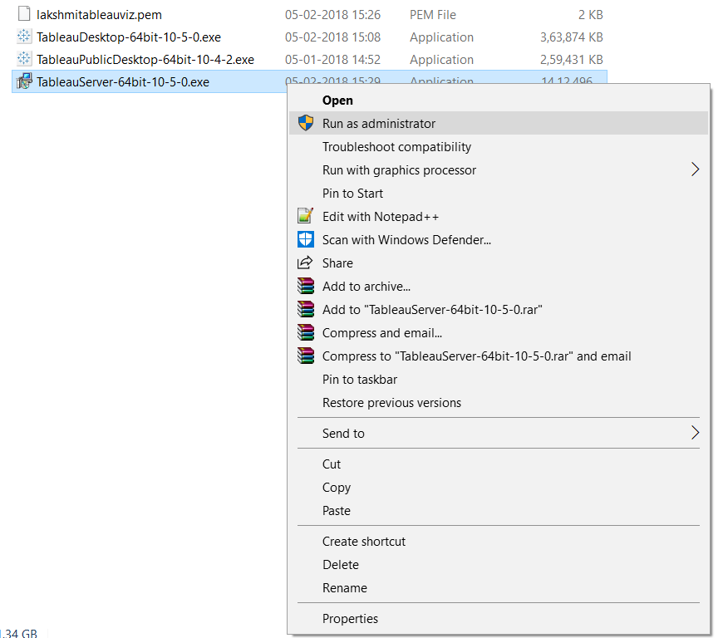
Installation
©
2018 CRG Solutions Pvt. Ltd

Slide 54
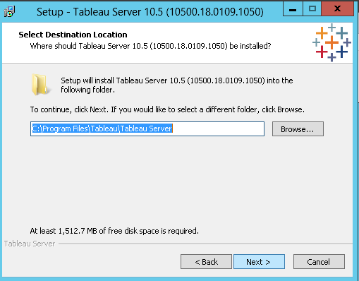
Installation Continue…
©
2018 CRG Solutions Pvt. Ltd

Slide 55
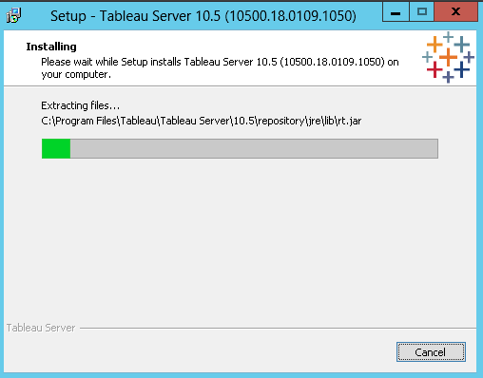
©
2018 CRG Solutions Pvt. Ltd

Slide 56
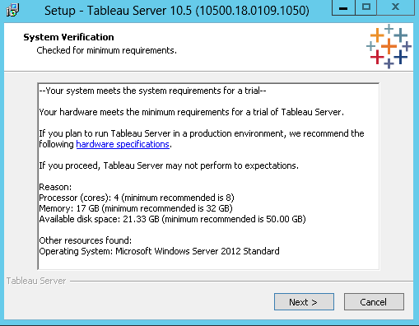
©
2018 CRG Solutions Pvt. Ltd

Slide 57
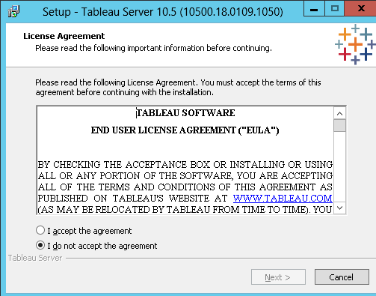
Click on “I accept the agreement”
©
2018 CRG Solutions Pvt. Ltd

Slide 58
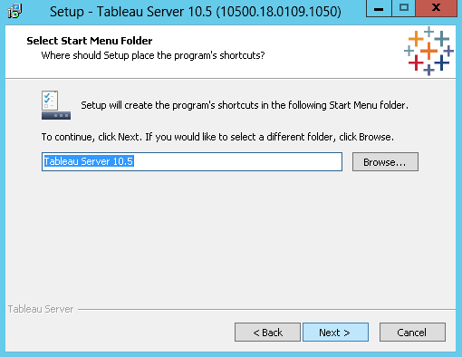
©
2018 CRG Solutions Pvt. Ltd

Slide 59
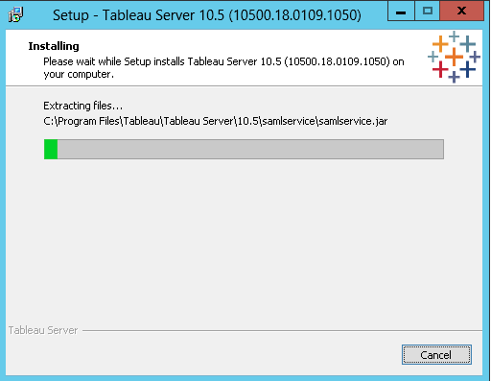
©
2018 CRG Solutions Pvt. Ltd

Slide 60
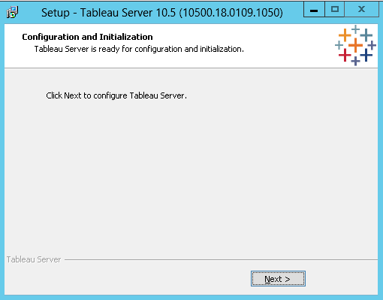
©
2018 CRG Solutions Pvt. Ltd

Slide 61
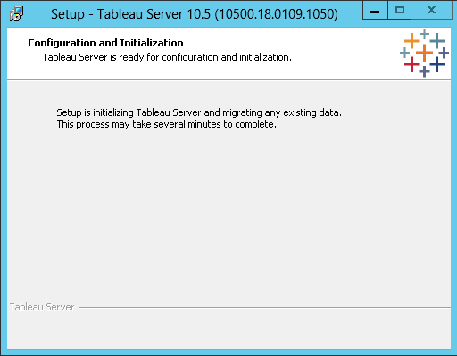
©
2018 CRG Solutions Pvt. Ltd

Slide 62
©
2018 CRG Solutions Pvt. Ltd

Slide 63
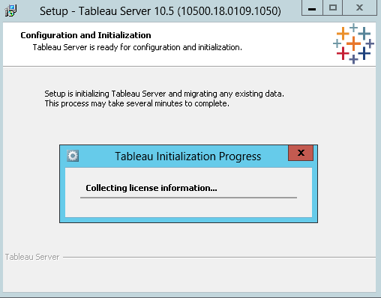
©
2018 CRG Solutions Pvt. Ltd

Slide 64
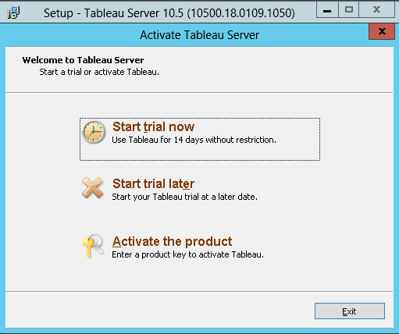
©
2018 CRG Solutions Pvt. Ltd

Slide 65
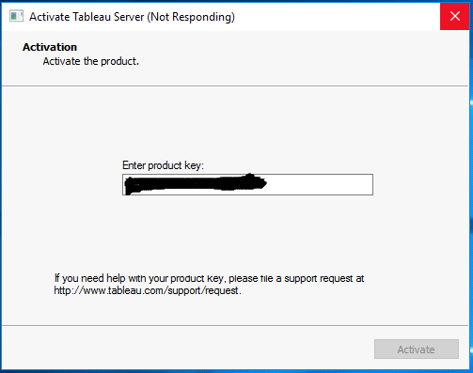
Activate the Product if you have product license, otherwise can be use as a trial version also (14 days trial version).
©
2018 CRG Solutions Pvt. Ltd

Slide 66
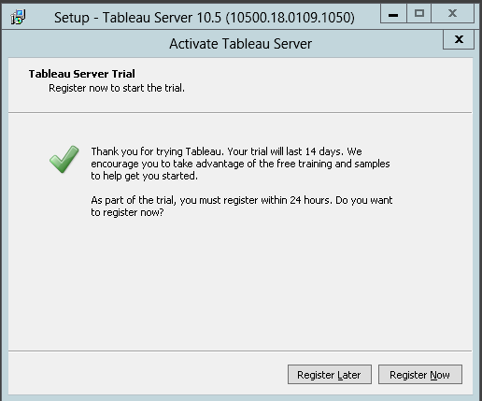
©
2018 CRG Solutions Pvt. Ltd

Slide 67
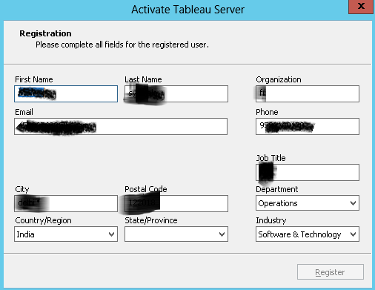
If you are using trial version fill the information within the 24 Hrs, otherwise server will not work.
©
2018 CRG Solutions Pvt. Ltd

Slide 68
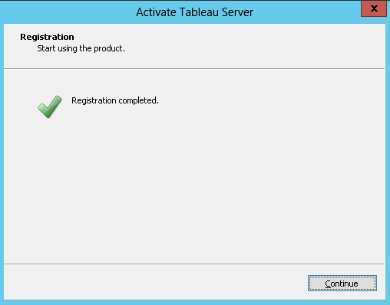
Registration Completed.
©
2018 CRG Solutions Pvt. Ltd

Slide 69
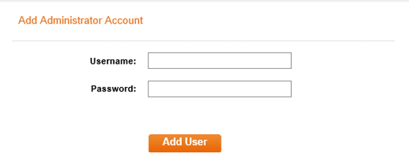
After Completion of installation, it will ask for Creating the Administrator user for Tableau Server.
User:- (This is user should be a part of Active Directory) Password:- *******
©
2018 CRG Solutions Pvt. Ltd

Slide 70
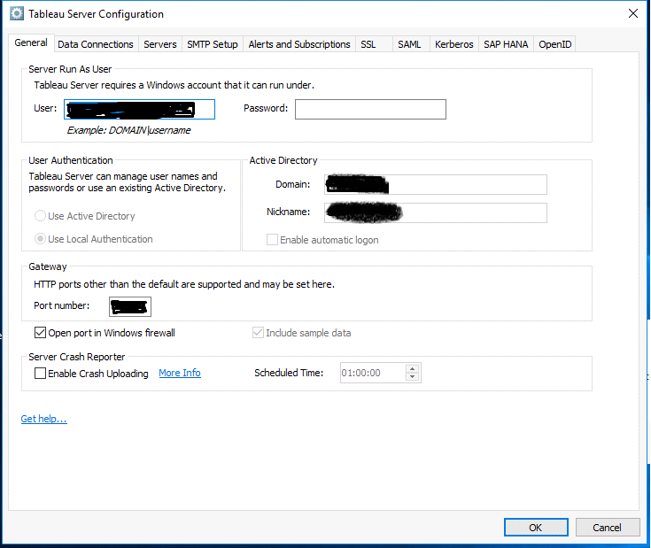
Tableau Server Configuration utility.
©
2018 CRG Solutions Pvt. Ltd

Slide 71
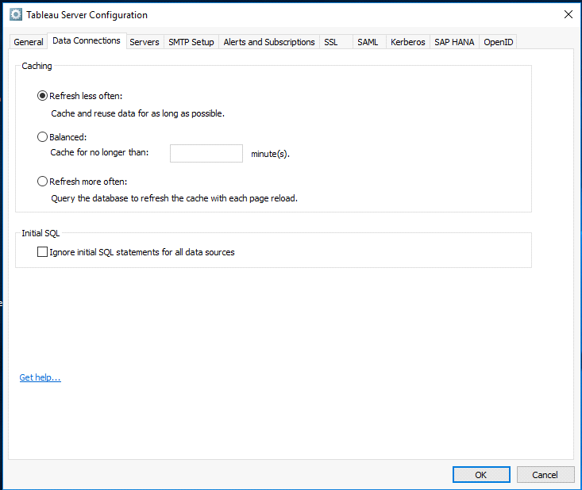
©
2018 CRG Solutions Pvt. Ltd

Slide 72
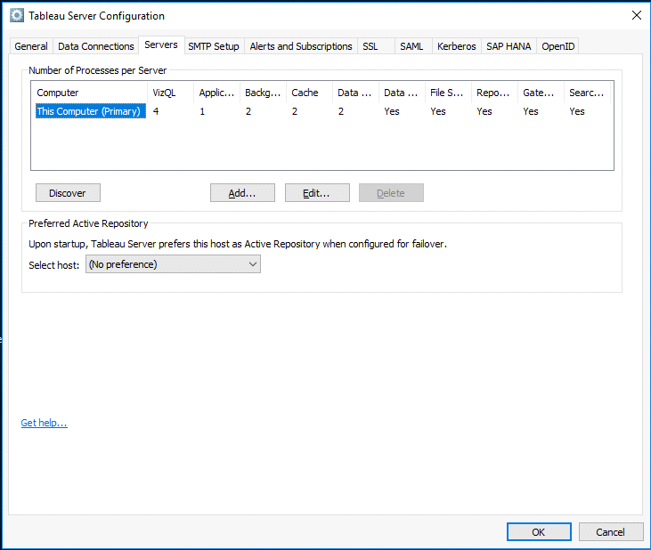
No. of process per server, here we mentioned the which services should run on which servers.
©
2018 CRG Solutions Pvt. Ltd

Slide 73
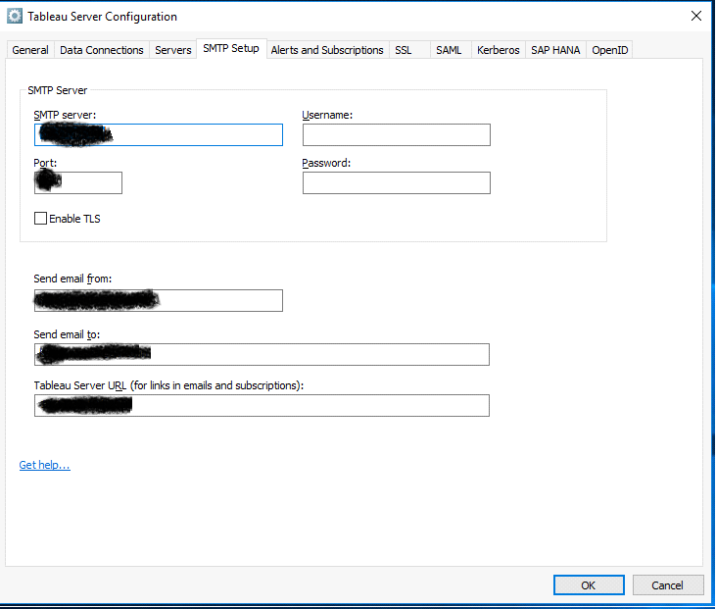
SMTP Setup Tab
©
2018 CRG Solutions Pvt. Ltd

Slide 74
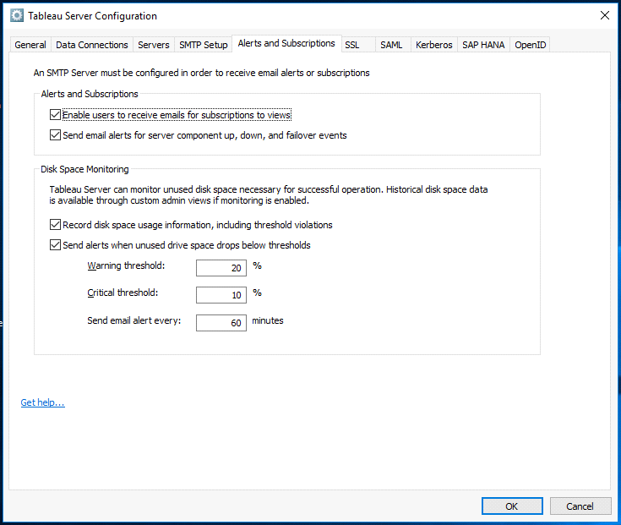
©
2018 CRG Solutions Pvt. Ltd

Slide 75
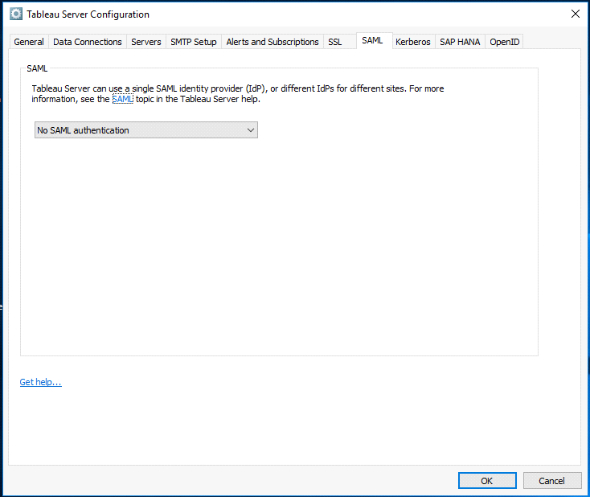
©
2018 CRG Solutions Pvt. Ltd

Slide 76
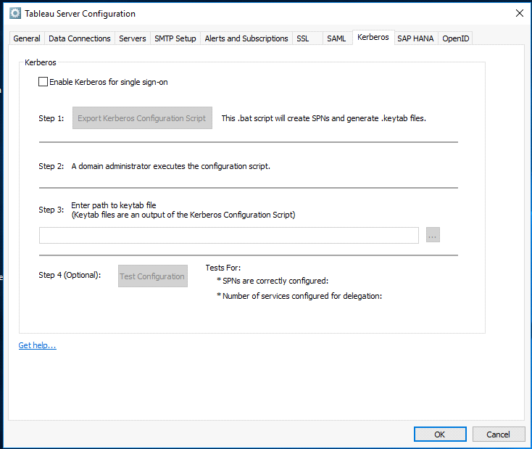
©
2018 CRG Solutions Pvt. Ltd

Slide 77
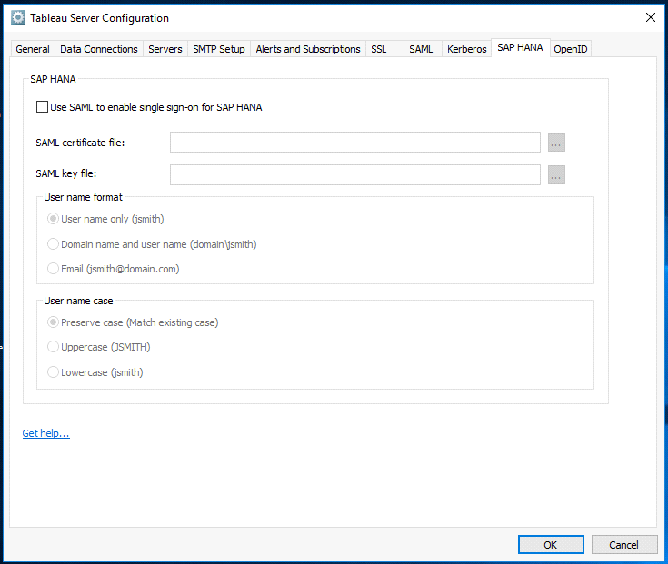
©
2018 CRG Solutions Pvt. Ltd

Slide 78
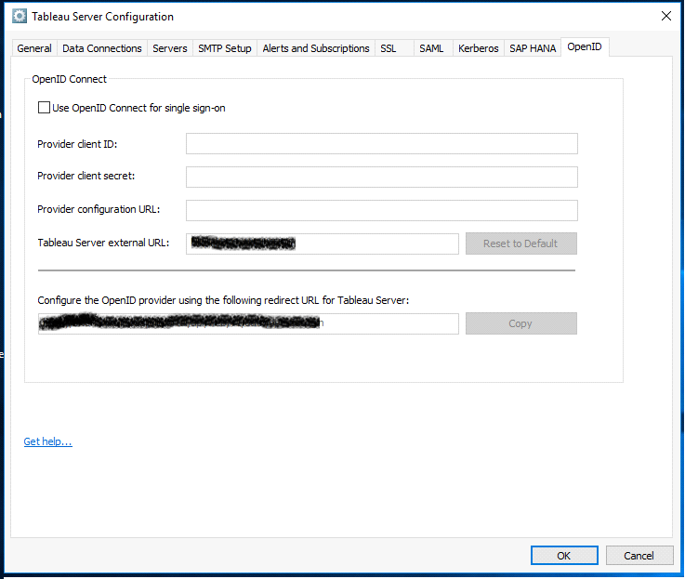
©
2018 CRG Solutions Pvt. Ltd

Slide 79
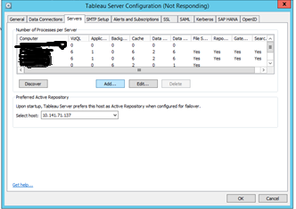
Making Tableau Cluster.
Ready the Tableau Worker, by installing Tableau worker setup on that.
Stop the Tableau Server.
Open the Tableau Server Configuration utility.
To add nodes, there are 2 ways
1. Click on Discover tab
2. Click on Add tab and enter the IP address of the worker node
©
2018 CRG Solutions Pvt. Ltd

Slide 80
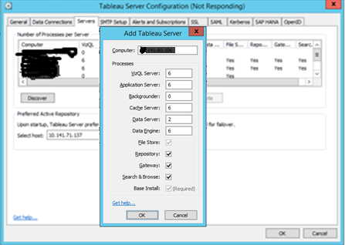
Enter the No. of services which needs to be running on the worker node.
Here for example we are adding 2 worker nodes.
©
2018 CRG Solutions Pvt. Ltd

Slide 81
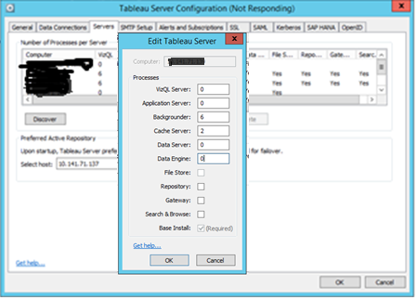
Enter the No. of services which needs to be running on the worker node.
Here for example we have made one worker as dedicated backgrounder node.
Click on OK button.
©
2018 CRG Solutions Pvt. Ltd

Slide 82
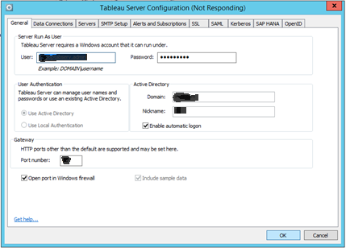
Saving the new configuration.
Enter the Password for “Server run As User”
©
2018 CRG Solutions Pvt. Ltd

Slide 83
Saving the new configuration.
©
2018 CRG Solutions Pvt. Ltd

Slide 84

Saving the new configuration.
Rebuilding search index.
©
2018 CRG Solutions Pvt. Ltd

Slide 85
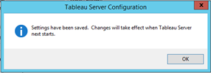
Setting changed and save..
Rebuilding search index.
Start the tableau server and check the status of the server.
Done with Tableau Server Clustering.
©
2018 CRG Solutions Pvt. Ltd

Slide 86


Contact Us
Mumbai
Gurgaon
Bengaluru
002, Eco House, Visweshwar Nagar, Goregaon East, Mumbai 400062
122, Vipul Business Park, Sector 48, Gurgaon 122002
Site No – 7 First Floor, Sri Sai complex, Near Ring Road, Ramamurthy Nagar Main Road, Banasawadi, Bengaluru, Karnataka 560043
0124-4039421
022-29271134
+91 94485 37401
©
2018 CRG Solutions Pvt. Ltd

